Slide 1
DEMO surveillance
WPMAT
MAT-1.1.2-T004-D002
Natalia Luzginova, CCFE
M. Gorley, CCFE

Slide 2
Deliverable Specification
Deliverable: Summary report on DEMO surveillance scheme for year 2016
Objectives in 2016 (June-September):
Lessons from fission reactor surveillance programmes
Initial surveillance concept and principals
Effort: 0.1 ppy

Slide 3
Introduction - DEMO surveillance scheme
It is recognized that end-of-life data for the in-vessel components will not be available for start-up of DEMO
However, there is precedence elsewhere for the operation of a first-of-a-kind nuclear plant in the absence of such data
UK MAGNOX fission plants (Porton, Fusion Eng Design 2016)
Flexible safety case, surveillance canisters and a substantial material archive to support lifetime estimations of the gas-cooled fission reactor
ASTM standards development (E10 committee)
ASTM E185 standard for all light-water moderated nuclear power reactor vessels
It is based on the knowledge accumulated at different nuclear power plants (starting from 1960); the first full-scale atomic electric power plant (PWR, Pressurized Water Reactor) was deployed in 1957

Slide 4
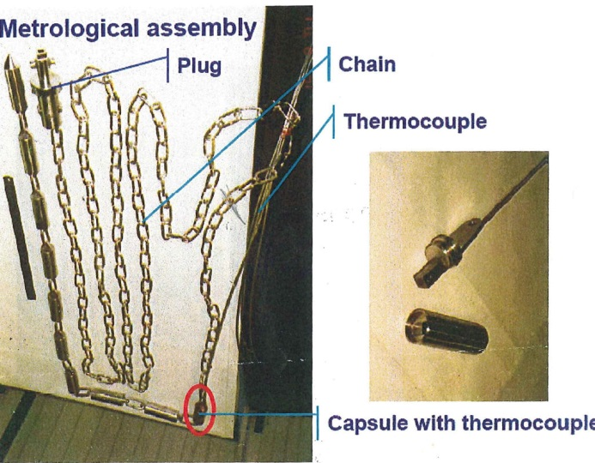
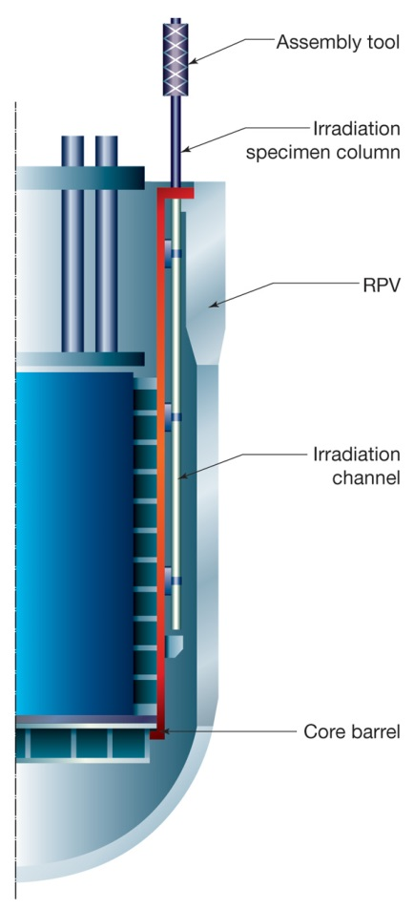
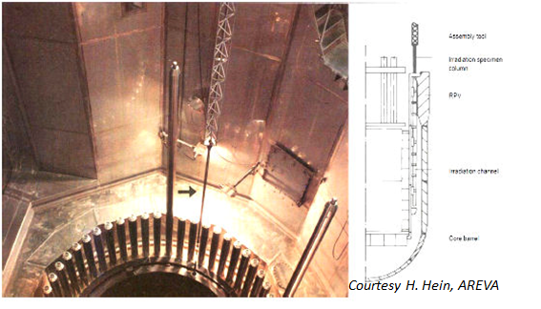
Lessons from fission surveillance programmes
Reactor surveillance programme – periodic withdrawal of test specimens (base and weld materials) to monitor materials properties degradation ahead of time (lead factor) and at the most affected location (beltline region)
Surveillance capsule and assembly tool
Stainless steel capsule with RPV material (Charpy and tensile) specimens
Material
Surveillance Material
Material Quality
Material Quantity
Location
Lead factor
Capsule
Specimen Withdrawal
Schedule
Review
Testing
Specimens and Tests
Dosimetry and Temperature Monitors
Supplemental Data
Important definitions
LONGLIFE project

Slide 5
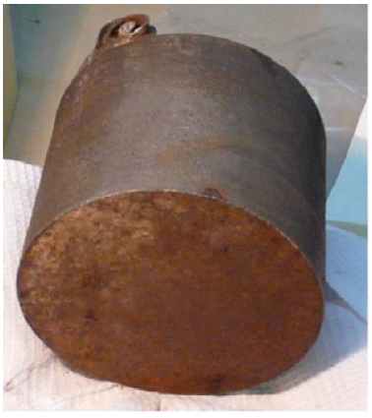
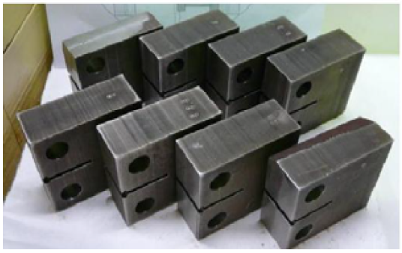
Lessons from fission surveillance programmes
A removal of damaged components OR components at the end of the lifetime OR through wall probes (trepans) can provide useful information on the materials performance via destructive testing
E. Krasikov, J Appl Mech Eng 2016
Manufacturing of 1T C(T) specimens from 140 mm in diameter EPR RPV trepans

Slide 6
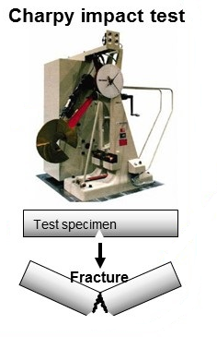
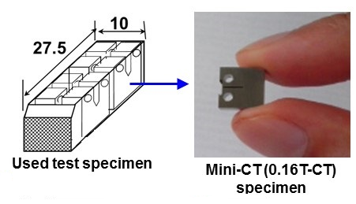
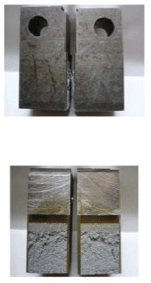
Lessons from fission surveillance programmes
A flexible design and an amendable concept to consider new advances in materials science/engineering and to implement state of the art mechanical materials testing
Retain sufficient amounts of limiting materials in the materials archives
From standard tensile and impact testing to fracture mechanics and structural integrity assessment methodology
1T C(T)
JAEA (www.jaea.go.jp)
E. Krasikov, J Appl Mech Eng 2016

Slide 7
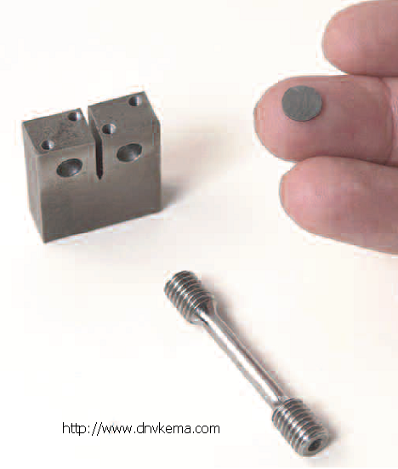
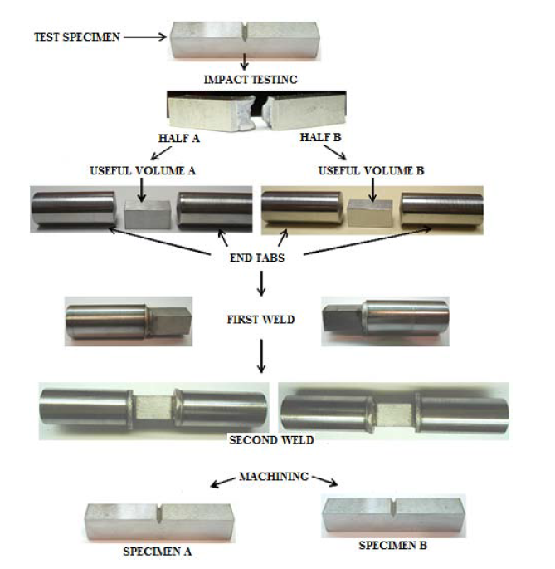

Lessons from fission surveillance programmes
A flexible design and an amendable concept to consider new advances in materials science/engineering and to implement state of the art mechanical materials testing
Retain sufficient amounts of limiting materials in the materials archives
M. Serrano, 2015
Complementary data to understand the underlining materials degradation mechanisms
state of the art materials testing techniques and microscopy
specimen reconstitution techniques
advanced damage and micromechanical modelling
Small Specimen Test Technology
Specimens reconstitution
ASTM E1253

Slide 8
DEMO surveillance purpose
DEMO surveillance programme purpose seems to be threefold:
To monitor the limiting materials condition ahead of time for permanent and semi-permanent surveillance components. It might include either non-destructive in-situ testing or Post Irradiation Examination (PIE)
To extract the replaceable components or a part of it at the end of the component life time for the follow up PIE
To populate the materials database with engineering relevant information; PIE of either non-limiting materials or limiting materials of the non-surveillance components
To be critically reviewed and adjusted (if needed)

Slide 9
DEMO surveillance definitions (priority)
Surveillance components
Surveillance component is a critical component, which integrity has a major importance to ensure the performance of the DEMO reactor
Failure of the surveillance component is unacceptable at any time
Surveillance component is a non-replaceable component or its replacement is technically challenging and costly in terms of either money or time

Slide 10
DEMO surveillance definitions (priority)
Limiting materials
Materials that are likely to limit the operation of the surveillance components
Minimum - (1) base metal from the actual plate(s) or forging(s) used in manufacturing of the surveillance component, and (2) joints made with the same heat of filler material and by the same joining procedure as that used for the surveillance component joints
The originally foreseen limiting materials may change during the DEMO reactor operating life time due to changes in the predicted degradation mechanisms and materials behaviour, first surveillance result analysis, or other factors
Flexibility in the surveillance scheme design

Slide 11
DEMO surveillance definitions (secondary)
Materials testing
Irradiation parameters
Neutron fluence and Lead factor
Irradiation temperature
Location and withdrawal schedule
Recommendations for these definitions can be found in the Deliverable report

Slide 12
Recommendations for 2017 and beyond
Before any advancement in the DEMO surveillance conceptual plan and design the following should be formulated and approved:
DEMO surveillance programme objectives. A possible threefold purpose of the DEMO surveillance programme has been expressed. It should be critically reviewed and adjusted (if needed)
DEMO surveillance components. The DEMO reactor components need to be assessed and the surveillance components shall be identified in accordance with definitions presented
Limiting Materials. The limiting materials for the DEMO surveillance components shall be identified, and materials availability to be included into both a surveillance capsule and a materials archive shall be assessed
Further development of what a Fusion specific surveillance scheme could look like and a conceptual plan for how this would be incorporated into the EU DEMO design should be carried out in a very close collaboration with other PPPT groups

